Slide 1

1d- Convolutional neural network for time series modeling
Bzdok Lab - Statsjam
June 27th, 2022

Slide 2
Same as 2D-CNN, 1D-CNN learns the patterns and useful features from raw data, but in 1D.
What are some common 1D data?
Audio signal, electrocardiograms (ECG), stock market price, EEG

Slide 3
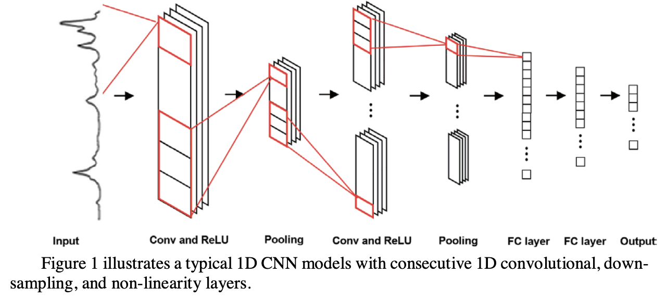
Basic structure
time
Mozaffari et al (2020)
Notes:
Here is an illustration of the basic 1d cnn structure. As you can see they are pretty similar to the 2d case. Conv layer activated by relu and followed by pooling layer, so on and so forth
On the first conv layer we have four kernels, each of the four kernels slides along the input and convolve with the part of the input they cover and gives back this array of outputs

Slide 4
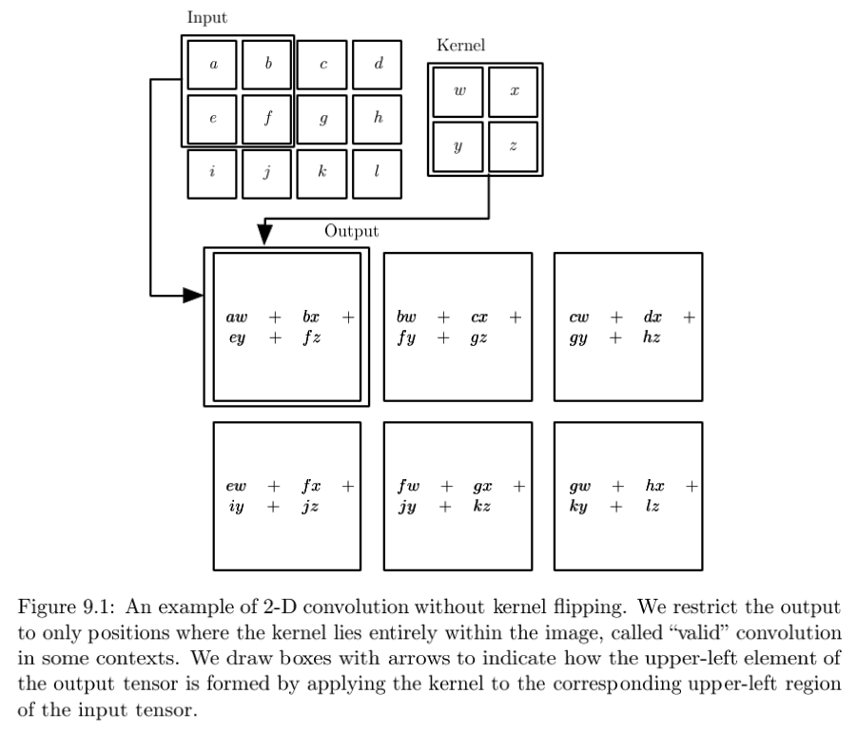
1d convolution vs 2d convolution
Credit: Brandon Rohrer
Goodfellow et al. (2016)
Notes:
1d convolution is just the sliding dot product between the kernel and the input, the same idea as in the 2d case

Slide 5
Why 1d?
Significantly lower computational complexity,
Fewer parameters (<10k) and compact network structures (usually 1-2 hidden layers in practice),
Therefore easier to implement and train on any hardware, suitable for real-time and low-cost application.
Notes:
1d cnn has some advantages over 2d.

Slide 6
Classification using 1d-cnn
Automatic speech recognition, a task where the extraction of patterns from the 1D speech signals is necessary.
Real-time electrocardiogram (ECG) monitoring; detection of arrythmia from ECG (abnormal heartbeat rhythm); detection of epileptic seizures from EEG signals.

Slide 7
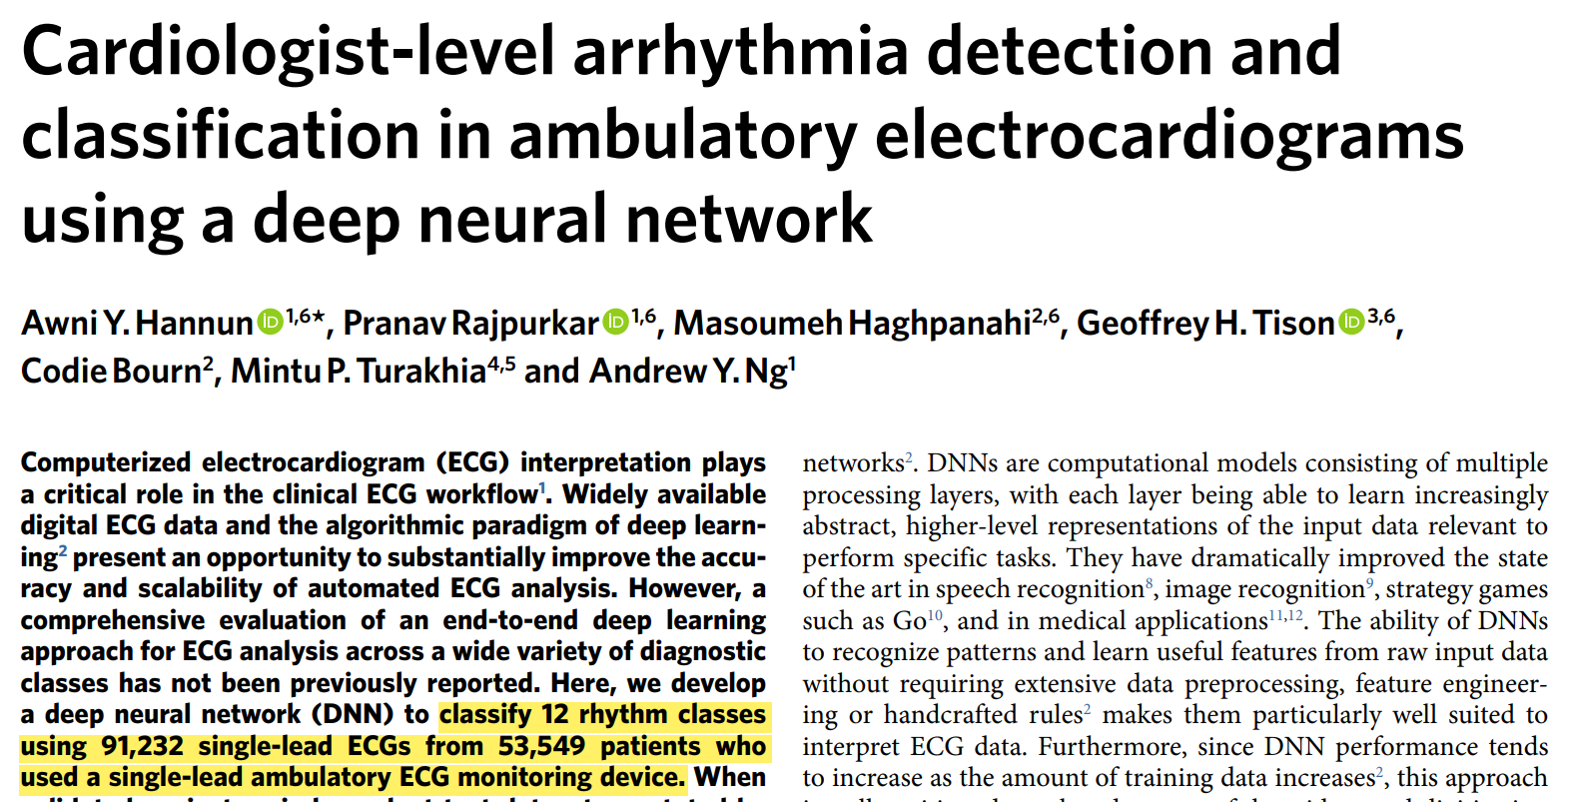

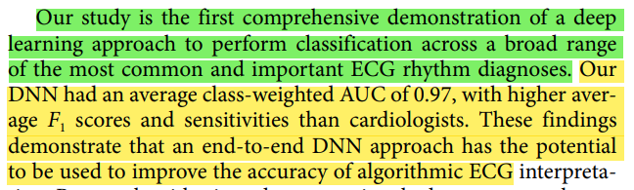
Notes:
In this study by Andrew Ng’s lab, they built a deep 1d cnn for ECG classification

Slide 8
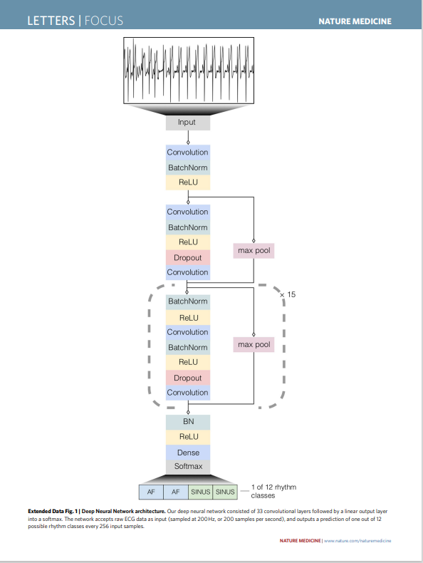
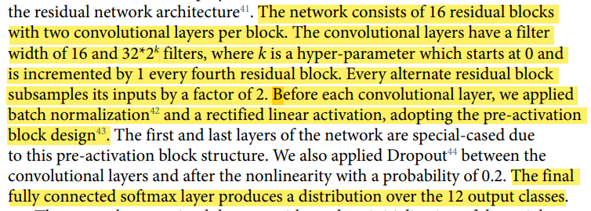
16
Notes:
Softmax acts as a confidence score of each label being the correct one, the label with the highest score is the final output.

Slide 9
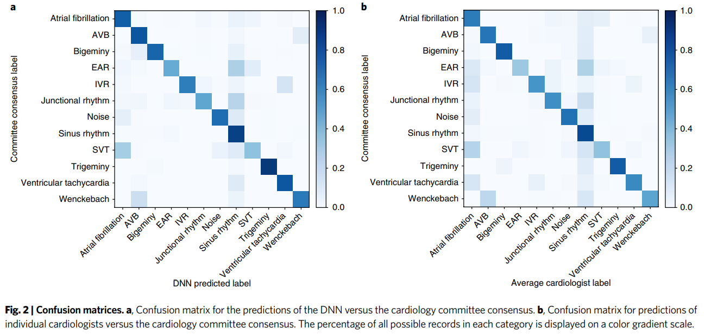
Notes:
DNN appears to recapitulate the misclassifications made by individual cardiologists, as demonstrated by the similarity in the confusion matrices for the model and cardiologists. Their manual review showed that these mistakes are reasonable, due to factors such as lack of contexts, limited signal precision and so on. So the network can’t overcome the inherent limitations within the data.

Slide 10
generating using 1d-cnn
Financial time series forecasting, learn filters (kernels) that represent certain repeating patterns in the series and use these to forecast the future value. (based on WaveNet)
Raw audio generation.
WaveNet by Deepmind

Slide 11
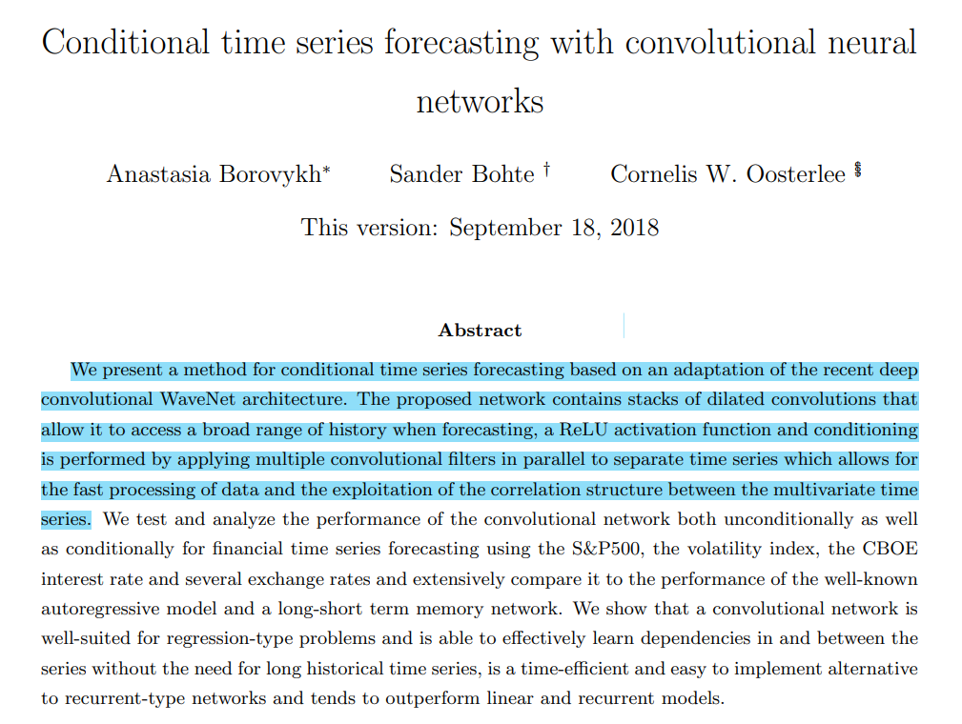

Slide 12
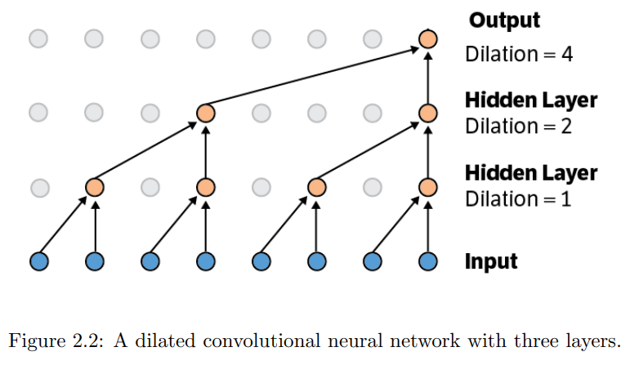
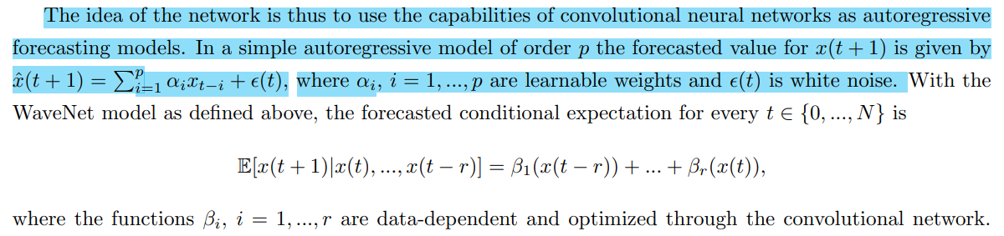
DILATED CONVOLUTION
Notes:
Weights are shared between different nodes on the same layer
Using the dilated convolutions allows the output to be influenced by more nodes in the input from past time steps.
In essence the model is an autoregressive model.

Slide 13
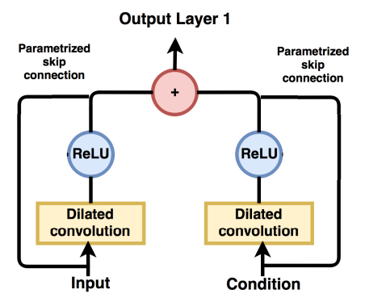
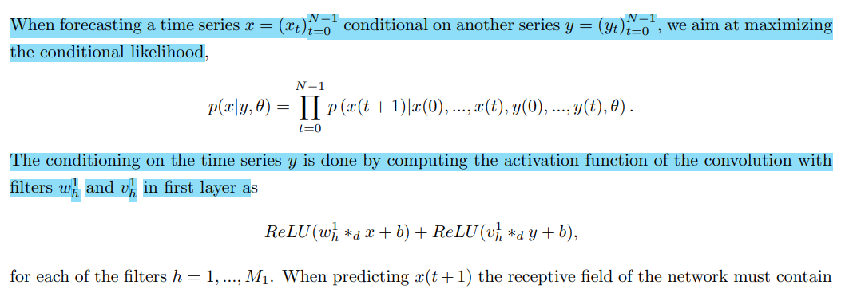
Conditioning
Notes:
Because the financial time series data are usually short in period and are noisy, conditioning on other different but highly correlated financial time series can increase both the robustness and forecasting quality. By leaning the long term temporal dependencies in between series.

Slide 14
references
Gao, Y., Gao, B., Chen, Q., Liu, J., & Zhang, Y. (2020). Deep Convolutional Neural Network-Based Epileptic Electroencephalogram (EEG) Signal Classification . In Frontiers in Neurology (Vol. 11). https://www.frontiersin.org/article/10.3389/fneur.2020.00375
Thomas, J., Comoretto, L., Jin, J., Dauwels, J., Cash, S. S., & Westover, M. B. (2018). EEG Classification Via Convolutional Neural Network-Based Interictal Epileptiform Event Detection. Annual International Conference of the IEEE Engineering in Medicine and Biology Society. IEEE Engineering in Medicine and Biology Society. Annual International Conference, 2018, 3148–3151. https://doi.org/10.1109/EMBC.2018.8512930
Hannun, A.Y., Rajpurkar, P., Haghpanahi, M. et al. Cardiologist-level arrhythmia detection and classification in ambulatory electrocardiograms using a deep neural network. Nat Med 25, 65–69 (2019). https://doi.org/10.1038/s41591-018-0268-3
Borovykh, A., Bohté, S.M., & Oosterlee, C.W. (2017). Conditional Time Series Forecasting with Convolutional Neural Networks. arXiv: Machine Learning.
Ian Goodfellow, Yoshua Bengio, & Aaron Courville (2016). Deep Learning. MIT Press.
Mozaffari, M.H., & Tay, L. (2020). A Review of 1D Convolutional Neural Networks toward Unknown Substance Identification in Portable Raman Spectrometer. ArXiv, abs/2006.10575.

